Slide 1
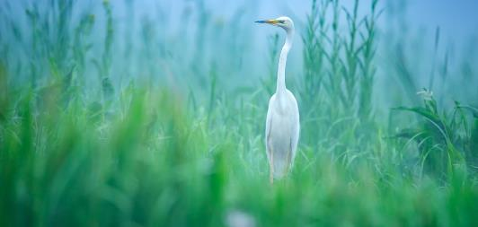
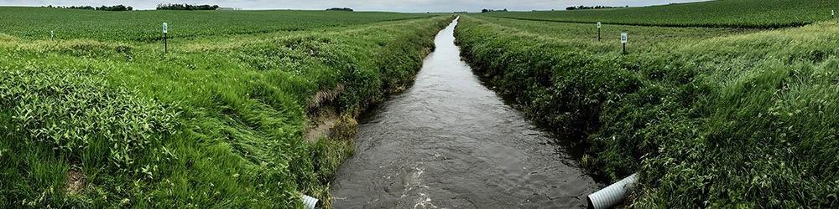
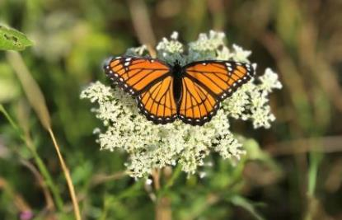

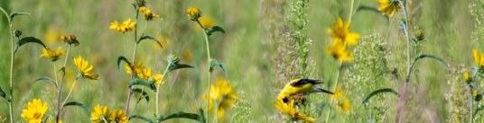
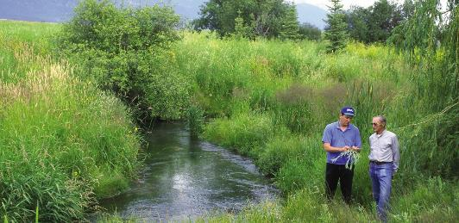

Slide 2
What is CREP?
Created to help protect our environment and wildlife
Part of the USDA Conservation Reserve Program (CRP).
Landowners receive cost-share assistance in establishing conservation practices:
  Grass planting
  Native grass planting
  Field windbreaks
  Filter strips
  Riparian forest buffer
  Wetland restoration
  Sediment retention-controlled structure.
Must agree to enroll eligible parcels of land in the program for 14-15 years.

Slide 3
Do I Qualify for CREP?
CREP priority watersheds include Lake Macatawa, River Raisin, and Saginaw Bay Watersheds.
Eligible land must be planted with an agricultural commodity four of the six years from 2012-2017.
Land must be physically and legally capable of being planted to an ag commodity in a normal manner.
Eligible priority zones limited to certain areas in some counties.
Your local USDA Farm Service Agency can help identify suitable parcels of land: farmers.gov/service-locator.

Slide 4
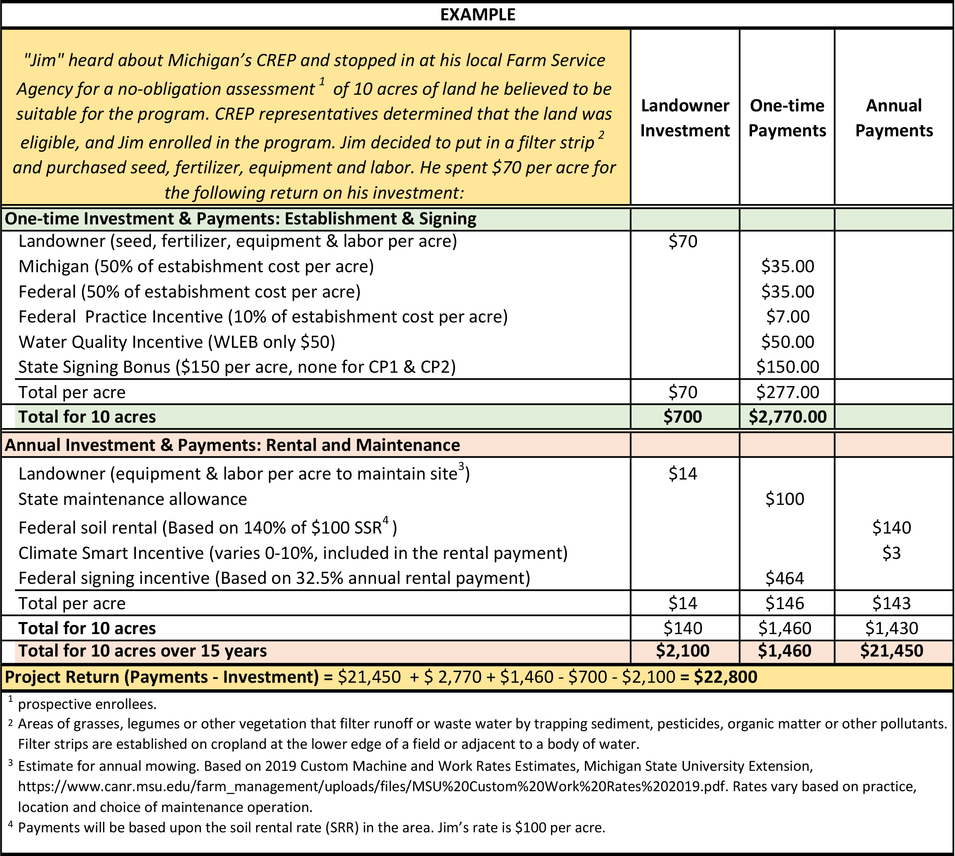
Financial Benefits

Slide 5
Environmental Benefits
Protect Michigan’s lakes, rivers, ponds and streams.
Filter runoff water of silt, pesticides, and other pollutants.
Replenish water tables.
Protect topsoil erosion.
Enhance wildlife habitat.
Encourage wildlife diversity.
Reduce flooding.
Increase oxygen levels.
Sequester carbon and improve soil health.

Slide 6
Value of Soil Organic Matter
Assumptions: 2,000,000 pounds soil in top 6 inches​
1% organic matter = 20,000#​
Nutrients:​
Nitrogen: 1000# * $0.65/#N = $650​
Phosphorous: 100# * $0.52/#P = $52​
Potassium: 100# * $0.55/#K = $55​
Sulfur: 100# * $0.50/#S = $50​
Carbon: 10,000# or 5 ton * $2/Ton = $10​
​
Value of 1% SOM Nutrients/Acre = $817 ​
​
Jim Kinsella/Terry Taylor (2006) Jim Hoorman (2011) Paul Gross (2013)​

Slide 7
Supplemental Programs for CREP (excluding EQIP)
Saginaw
Program | Administrator | Focus | Practices
P2P Farmer Network | IWR | Nutrient management adoption and nutrient load reduction
RCPP | TNC | Sediment reduction
GLRI Pay for Performance | TNC | Sediment reduction
Method Company Groundwater Recharge | TNC | Groundwater recharge
WLEB
Program | Administrator | Focus | Practices
GLRI Accelerating Conservation Adoption-RR | IWR | Phosphorus reduction
319 Implementation Grant Tom VanWagner- RR | Lenawee Conservation District Tom V. | Nutrient reduction?
319 St. Joe | Sarah Fronczak | Phosphorus reduction

Slide 8
CREP CP1, Establishment of Permanent Introduced Grasses and Legumes
Practice Requirements
acreage must have an Erodibility Index of 8 or greater
cropland must be immediately adjacent to an eligible waterbody, as determined by USDA, and not exceed a maximum average width of 1,000 feet from the edge of the eligible waterbody, unless documented according to the FOTG
be comprised of 5 species total. Minimum of 3 species of introduced grasses and at least 2 forb or legume species best suited for wildlife in the area

Slide 9
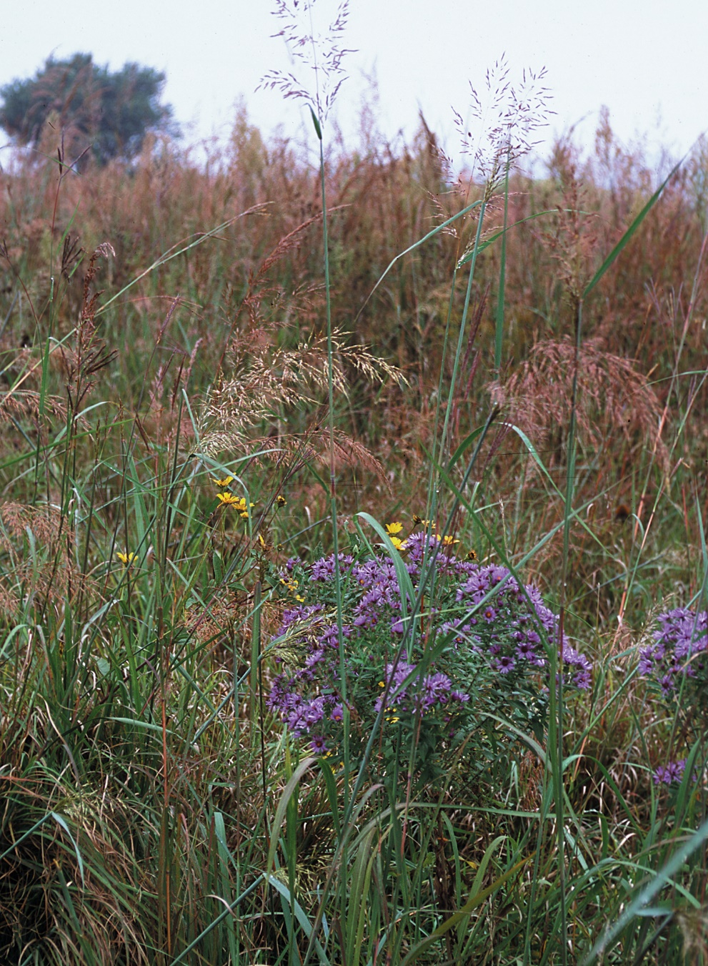
CREP CP2, Establishment of Permanent Native Grasses
Permanent Native Grasses are used to reduce soil erosion and sedimentation, improve water quality and create or enhance wildlife habitat.
Under the Michigan CREP agreement this practice is being implemented as a super-buffer. Wider grass filter strips are planted strategically on acres between fields and surface waters (rivers, streams, lakes and drainage ditches) to protect water quality.

Slide 10
CREP CP2, Establishment of Permanent Native Grasses
Practice Requirements
acreage must have an Erodibility Index of 8 or greater, wind or water, but NOT both combined.
cropland must be immediately adjacent to an eligible waterbody, as determined by USDA, and not exceed a maximum average width of 1,000 feet from the edge of the eligible waterbody, unless documented according to the FOTG
be comprised of at least 3 native grasses and 6 forb/wildflower species. At least 2 species must have their primary onset of blooming during each period of early, mid, and late season from approximately March through October. In addition to the 9 species of grasses and forbs, an optional native shrub beneficial to local wildlife may be included in the conservation cover.

Slide 11
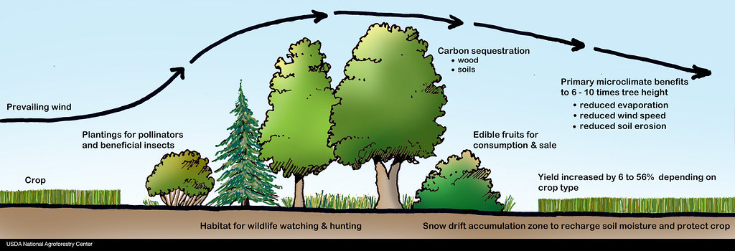
CREP CP5A, Field Windbreaks
Field windbreaks are linear plantings of trees/shrubs designed to reduce wind speed in open fields, preventing soil erosion and protecting adjacent crops from wind damage.
Field windbreaks are typically planted in multiple rows perpendicular to prevailing winds. On the downwind side of a well-established windbreak, wind is generally slowed for a distance of 10 times the height of the trees. Old field windbreaks may need renovation to function properly, including removal and replacement of selected trees/shrubs.

Slide 12
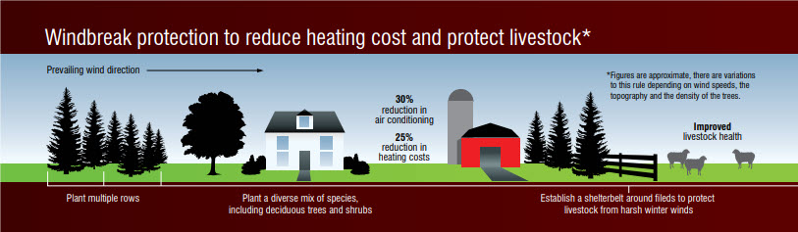
CREP CP5A, Field Windbreaks
Why establish field windbreaks?
Environmental benefits
Reduces soil erosion from wind
Protects water and air quality by providing a barrier against airborne soil, chemical drift, odors and dust
Provides wildlife food, cover and travel corridors
Diversifies agricultural landscapes
Sequesters carbon

Slide 13
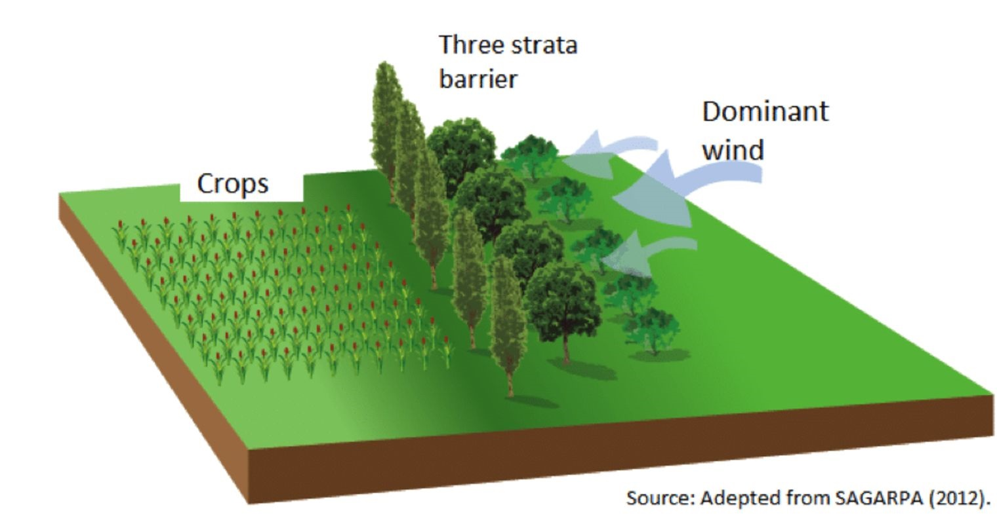
CREP CP5A, Field Windbreaks
Why establish field windbreaks?
Practical benefits
Protects crops from wind damage
May increase crop yields by 10% or more, especially in dry years
May improve crop photosynthesis and water use efficiency due to micro-climate changes in temperature and humidity
Improves irrigation efficiency
Helps manage snow drifts and soil moisture by dispersing snow more evenly across cropland
Provides opportunities for additional income from salable tree/shrub products such as nuts, berries and decorative floral material
Adds scenic interest to fields and may increase property values

Slide 14
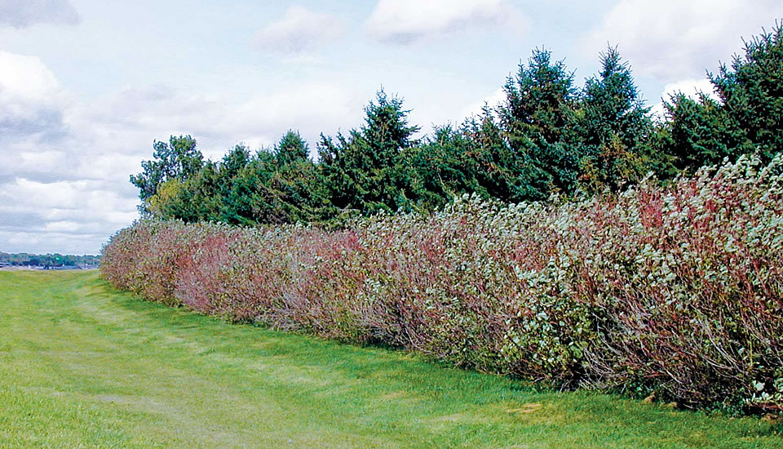
CREP CP5A, Field Windbreaks
Practice Requirements
The cropland must be devoted to a cover comprised of:
a minimum of 1 row of trees and 2 rows of shrubs
a maximum of 2 rows of trees plus 3 rows of shrubs.
Note: Species are limited to those in the FOTG. The maximum width of field windbreaks and the spacing between windbreaks will be the minimum needed to reduce cropland erosion, according to the FOTG, regardless of the purpose of the windbreak (windbreak density of at least 40%).

Slide 15
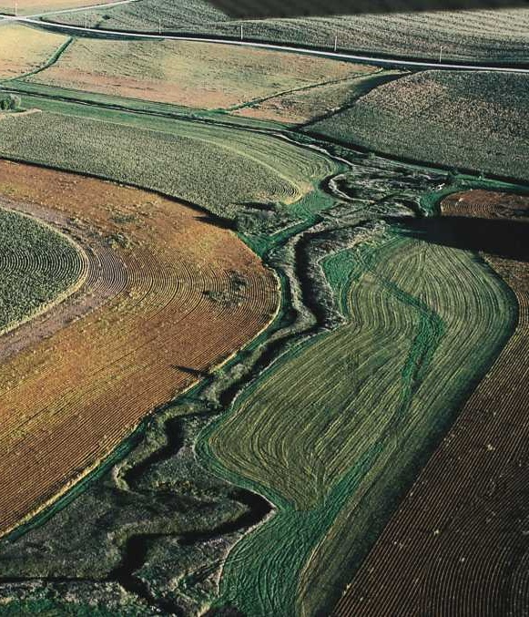
CREP CP21, Filter Strips
Grass filter strips are planted strategically between fields and surface waters (rivers, streams, lakes and drainage ditches) to protect water quality. They slow runoff from fields, trapping and filtering sediment, nutrients, pesticides and other potential pollutants before they reach surface waters.

Slide 16
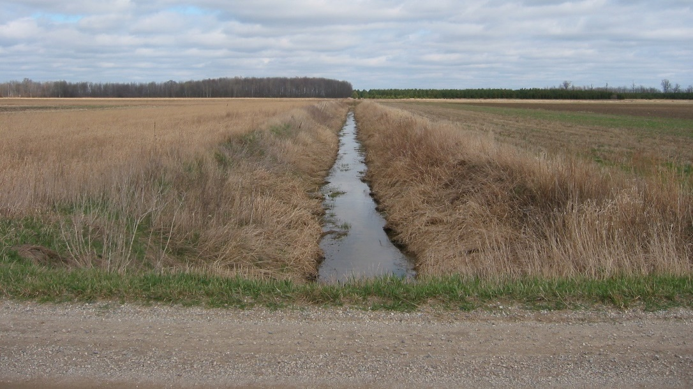
CREP CP21, Filter Strips
Example
A field with 5-acres of filter strips
Without filter - deposits 6.2 tons of sediment, 9.5 pounds
of phosphorus, and 20 pounds of nitrogen
With filter - reduces 4 tons of sediment, 7 pounds
of phosphorus, and 14 pounds of nitrogen
Environmental Impact
Reduces delivery of:
Sediment: 65%
Nitrogen: 70%
Phosphorous: 75%

Slide 17
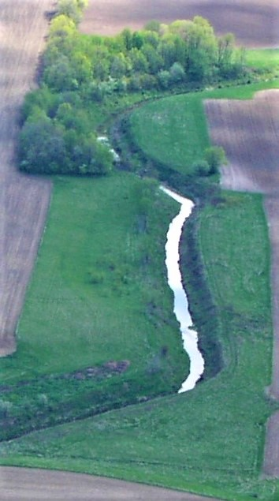
CREP CP21, Filter Strips
Practice Benefits
Provides an alternative for marginal, flood-prone cropland along creeks and streams
Straightens irregular fields, keeps farm machinery away from steep banks and avoids the need to plant end-rows where crop yields are often lower due to soil compaction

Slide 18
CP21, Filter Strips
Practice Benefits, continued
May reduce flood damage on adjacent cropland
May lower expenses for drainage ditch maintenance
Aids compliance with setback requirements for manure application and certain herbicide labels
Creates a highly visible sign of good stewardship
Provides habitat for important pollinator species that many crops rely upon, such as bees

Slide 19
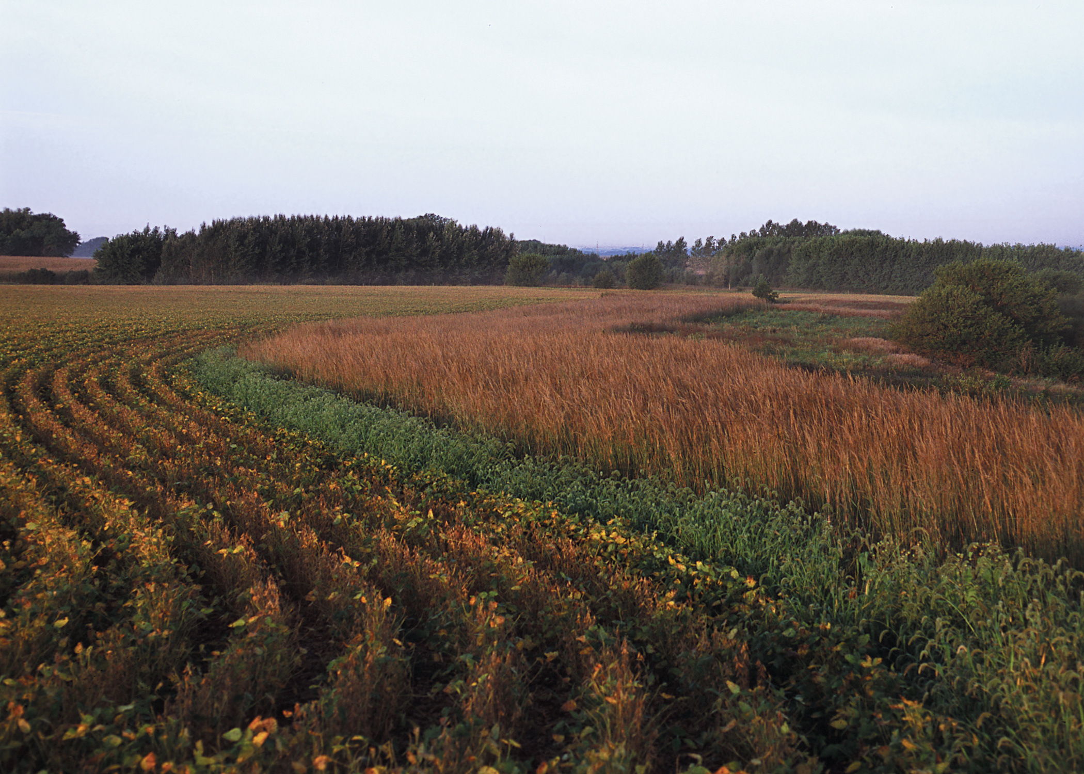
CREP CP21, Filter Strips
Practice Requirements
Under CREP, the minimum average width not less than 50 feet, and the average maximum width not to exceed 150 feet. The minimum acceptable width of a filter strip is 20 feet.
Depending on site characteristics, landowner goals, applicable regulations and voluntary conservation program requirements. Wider filter strips provide greater wildlife habitat benefits.

Slide 20
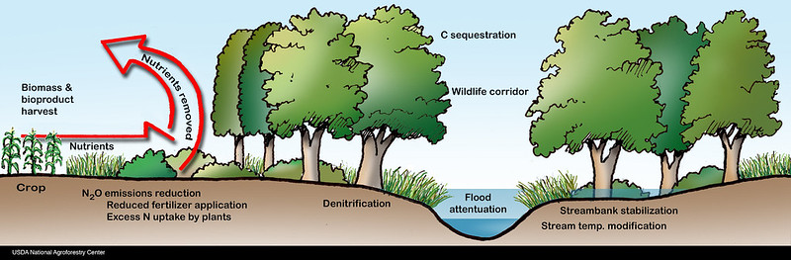
CREP CP22, Riparian Buffers
Riparian buffers are the natural vegetation from the edge of the stream bank out through the riparian zone. The vegetative zone serves as a buffer to pollutants entering a stream from runoff, controls erosion, and provides habitat and nutrient input into the stream.

Slide 21
CREP CP22, Riparian Buffers
Why establish Riparian Buffers?
Environmental benefits
protects water quality by reducing the amount of sediment, excess nutrients, pesticides and other pollutants entering streams, ditches, lakes, wetlands and other surface water.
reduces excess nutrients and other chemicals in shallow groundwater flows.
slows floodwaters and reduces stream water volume.
helps stabilize stream banks and shorelines through root absorption.
provides shade, shelter and food for fish and other aquatic species; shade is especially important for cold-water species.
provides habitat and travel corridors for diverse plants and animals - especially birds, reptiles and others that require water with adjacent woods.

Slide 22
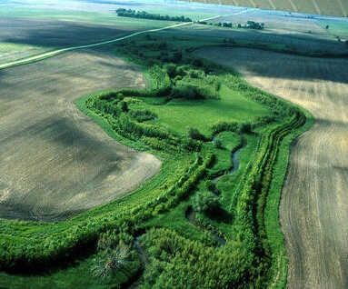
CREP CP22, Riparian Buffers
Why establish Riparian Buffers?
Practical benefits
provides woodland recreational opportunities such as fishing, hunting, birding, hiking and camping.
provides opportunities for additional income specialty woodland products such as nuts, berries, mushrooms, medicinal plants and decorative floral materials such as flowers, boughs, stems, and vines.
creates a highly visible sign of good stewardship, especially along recreational streams.
straightens irregular fields, keeps farm machinery away from steep banks, and avoids the need to plant end-rows

Slide 23
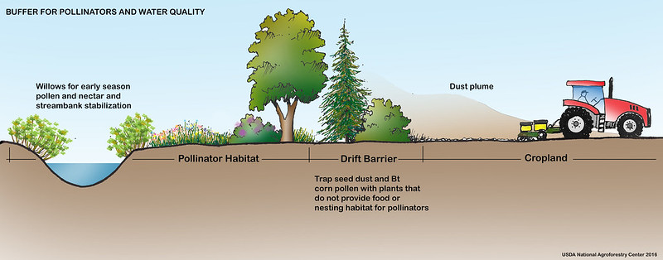
CREP CP22, Riparian Buffers
Why establish Riparian Buffers?
Practical benefits , continued
provides a barrier against nearby dust, odor, noise or light pollution.
adds scenic beauty and may increase property values.
provides habitat for important pollinator species.

Slide 24
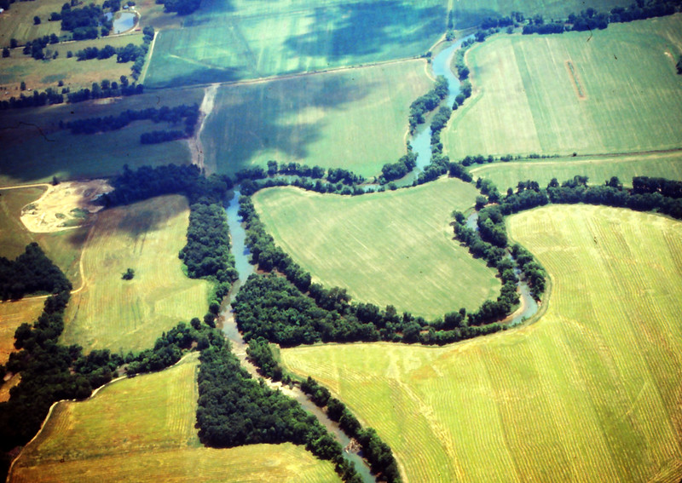
CREP CP22, Riparian Buffers
Practice Requirements:
Under CREP, the minimum average width not less than 50 feet, and the average maximum width not to exceed 180 feet. The minimum acceptable width of a riparian buffer is 35 feet.
Depending on site characteristics, landowner goals, applicable regulations and voluntary conservation program requirements. Wider riparian buffers provide greater water quality and wildlife habitat benefits.

Slide 25
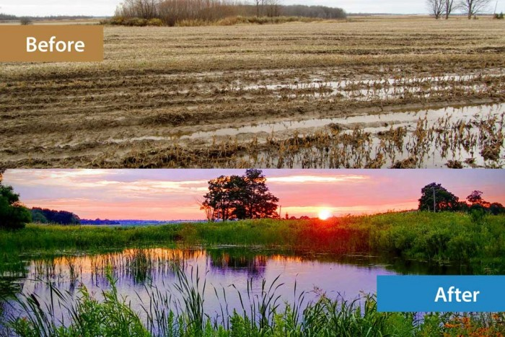
CREP CP23 and CP23A, Wetland Restorations
Wetland Restorations is the manipulation of a former or degraded wetland's physical, chemical, or biological characteristics to return its natural functions. Restoration practices include:
Re-establishment, the rebuilding a former wetland; and
Rehabilitation, repairing the functions of a degraded wetland

Slide 26
CREP CP23 and CP23A, Wetland Restorations
Why establish/restore wetlands?
Wetlands can play a role in reducing the frequency and intensity of floods by acting as natural buffers, soaking up and storing a significant amount of floodwater. A wetland can typically store about three-acre feet - three acres covered in water three feet deep - or one million gallons of water. Coastal wetlands serve as storm surge protectors when storms come ashore. Barrier islands, shoals, marshes, forested wetlands and other features of the coastal landscape can provide a significant and potentially sustainable buffer from wind wave action and storm surges.

Slide 27
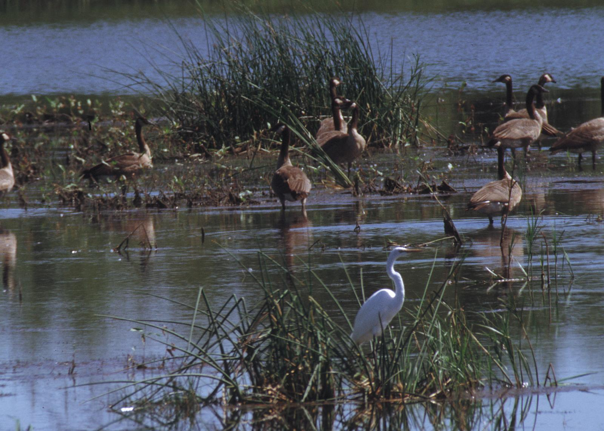
CREP CP23 and CP23A, Wetland Restorations
Why establish/restore wetlands?
Environmental benefits
Sixty-four percent of the world's wetlands have disappeared since 1900.
Only 3 percent of the world's water is fresh (and most of that is frozen). On average, each person uses five to 13 gallons of water per day for drinking, cooking, and cleaning. Wetlands help provide the clean, reliable supplies of freshwater people need for daily life.
Wildlife Nursery. Because of its unique location between water and land, salt and freshwater, wetlands shelter more than one-third of the country’s threatened and endangered species. Without wetlands, a huge number of songbirds, waterfowl, shellfish, mammals just wouldn’t exist.

Slide 28
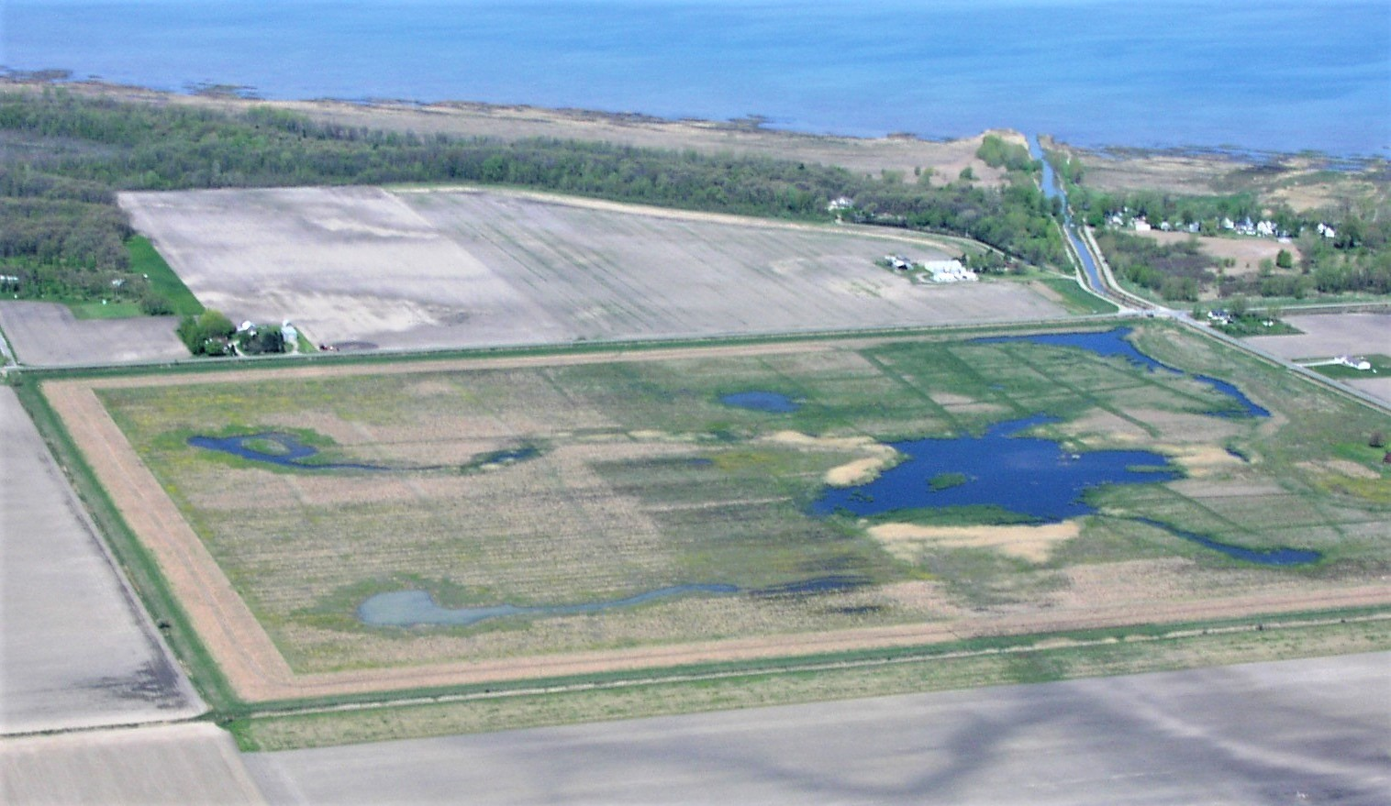
CREP CP23 and CP23A, Wetland Restorations
Why establish/restore wetlands?
Environmental benefits, continued:
Flood Control. Wetlands function like a sponge, soaking up water that comes in with the tides, or from periodically flooding rivers. In fact, they control floods much more effectively and efficiently than any floodwall.
Pollution Filter. If trees are the lungs of the planet, then wetlands are its kidneys. On the Rouge River near Detroit, Michigan, a wetland demonstration project showed significant reductions in nitrates, phosphorus, and heavy metals. Clean and plentiful drinking water depends on healthy wetlands.

Slide 29
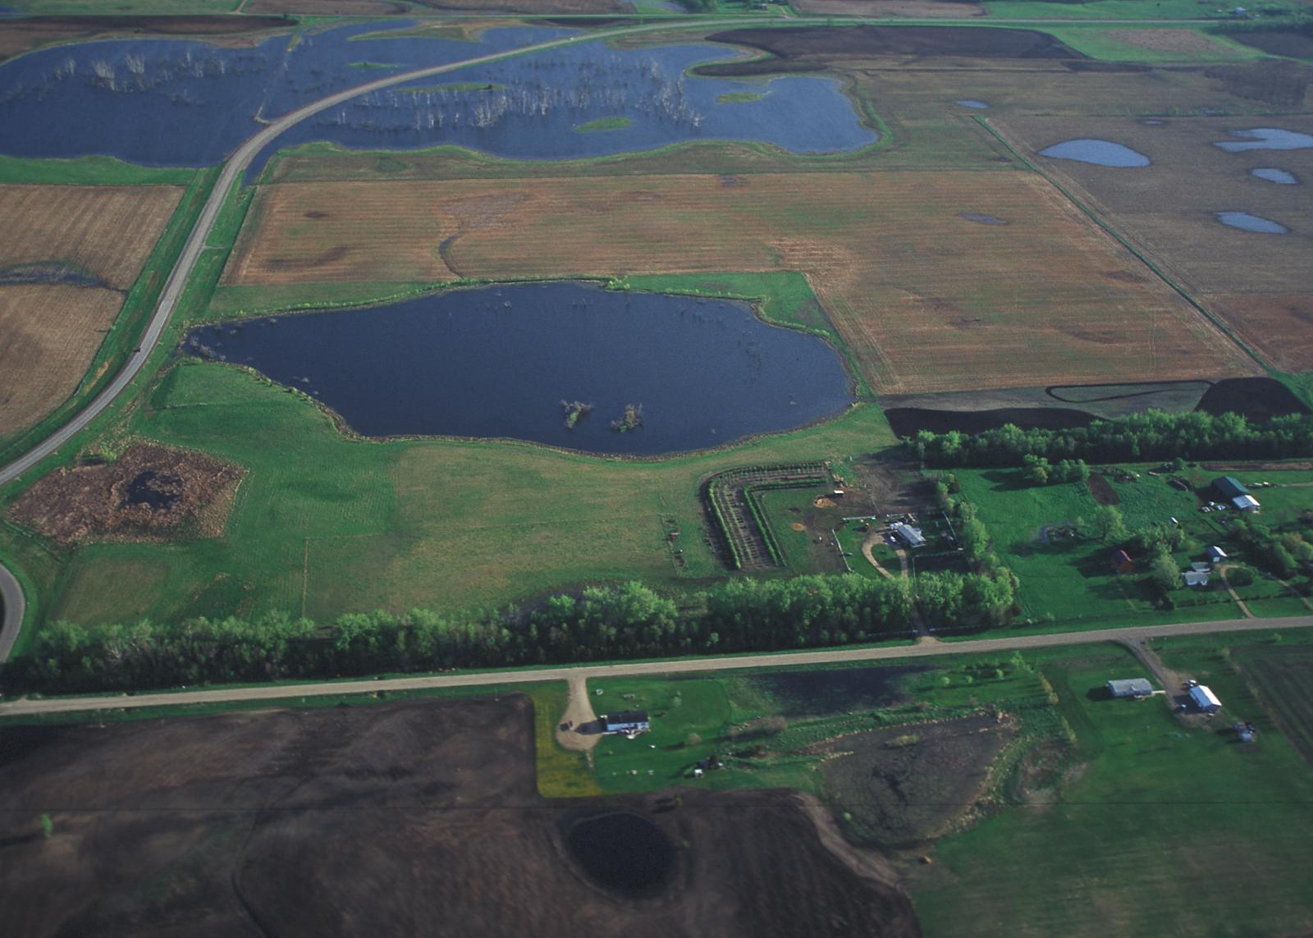
CREP CP23 and CP23A, Wetland Restorations
Why establish/restore wetlands?
Practical benefits
Restoring wetland ecosystems helps filter sediments and chemicals to improve water quality downstream, enhance wildlife and aquatic habitat, reduce impacts from flooding, recharge groundwater and offers recreational benefits.
Wetlands provide a perfect location for observing wildlife. Many species of neotropical migrant songbirds, waterfowl, amphibians, reptiles and other animals depend on these habitats
creates a highly visible sign of good stewardship
straightens irregular fields

Slide 30
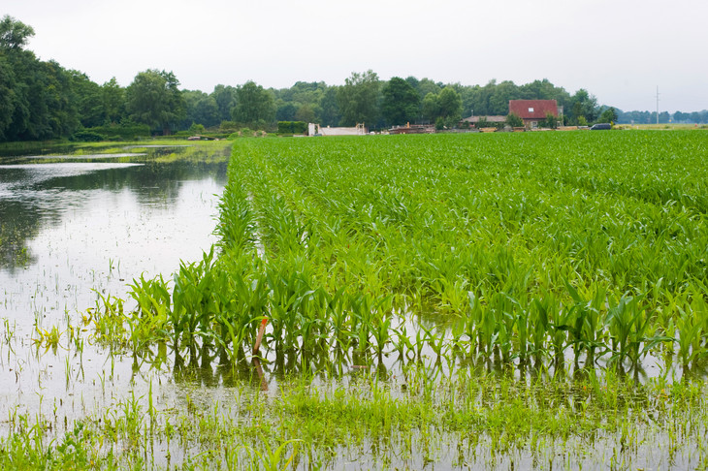
CREP CP23, Wetland Restoration
Practice Requirements
Total eligible cropland for wetland restorations is limited to cropland:
according to paragraph 151
within the 100-year floodplain of a permanent river or stream
that includes a minimum of 51 percent hydric soils for the acreage offered (nonbuffer
areas).
Notes: The purpose of this practice is to restore
the natural hydrology, NOT to create a wetland.
An offer that includes a buffer outside the 100-year floodplain may be enrolled if otherwise eligible, needed, and feasible for the practice

Slide 31
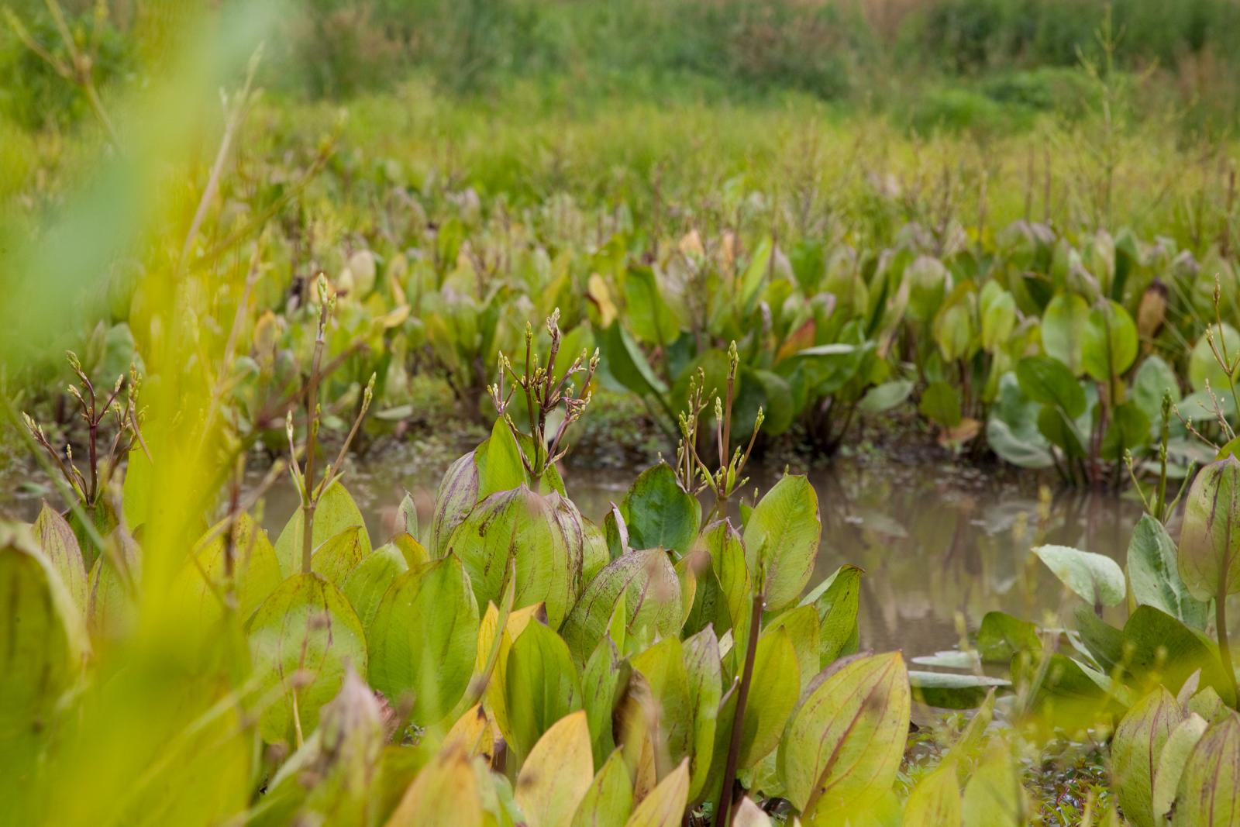
CREP CP23, Wetland Restoration
Practice Requirements
The amount of adjacent upland acreage to be enrolled shall be determined by NRCS. The amount of adjacent upland acres:
is limited to the minimum number of acres to provide a protective buffer to the cropped wetland and to enhance wildlife habitat
may be less than the 3 to 1 ratio
shall not exceed the 3 to 1 ratio

Slide 32
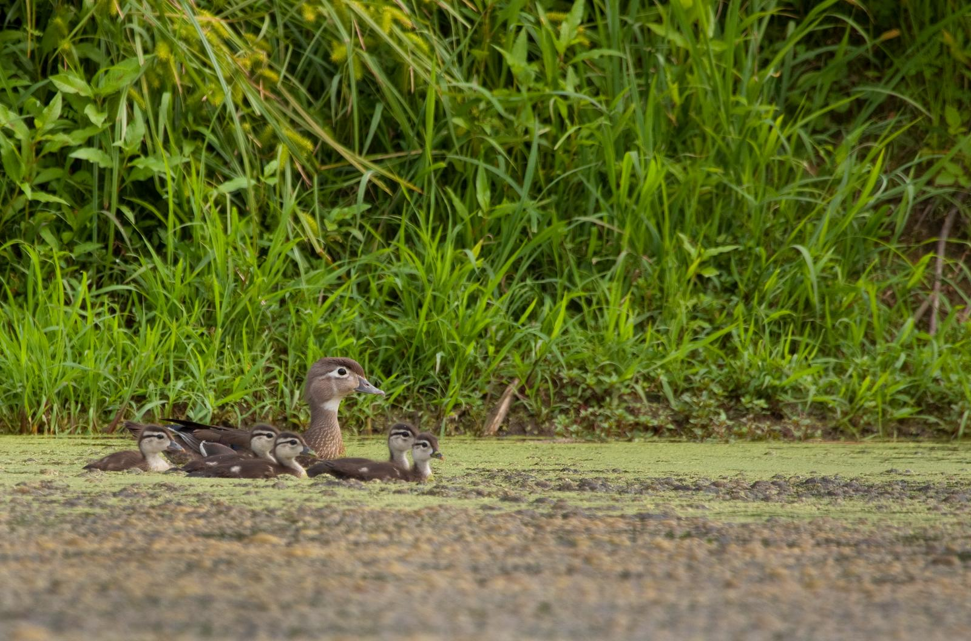
CREP CP23A, Wetland Restoration, Non-Floodplain
Practice Requirements
This practice must be:
located outside the 100-year floodplain
playa lakes
Eligible cropland must meet the requirements in subparagraph 181 A.
Notes: Cottonwoods may be planted to enhance the viability of other hardwood trees (oaks, etc.).
The purpose of this practice is to restore
the natural hydrology, NOT to create a wetland.

Slide 33
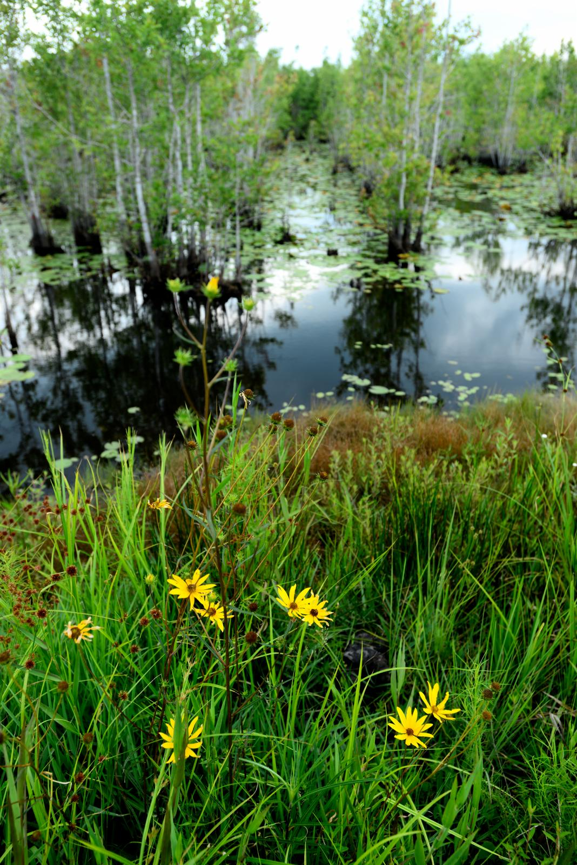
CREP CP23A, Wetland Restoration, Non-Floodplain
Practice Requirements
The amount of adjacent upland acreage to be enrolled shall be determined by NRCS. The amount of adjacent upland acres:
is limited to the minimum number of acres to provide a protective buffer to the cropped wetland and to enhance wildlife habitat
may be less than the 4 to 1 ratio
shall not exceed the 4 to 1 ratio

Slide 34
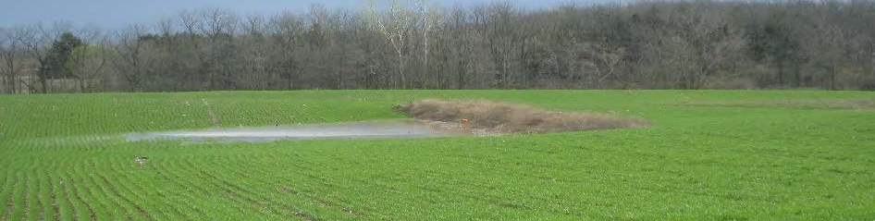
CREP CP26, Sediment Retention Control Structure
A water sediment retention control structure is a small earthen ridge-and-channel or embankment built across (perpendicular to) a small watercourse or area of concentrated flow within a field. They are commonly built in a parallel series with the first ridge crossing the top of the watercourse and the last ridge crossing the bottom, or nearly so. They are designed to trap agricultural runoff water and sediment as it flows down the watercourse; this keeps the watercourse from becoming a field gully and reduces the amount of runoff and sediment leaving the field.

Slide 35
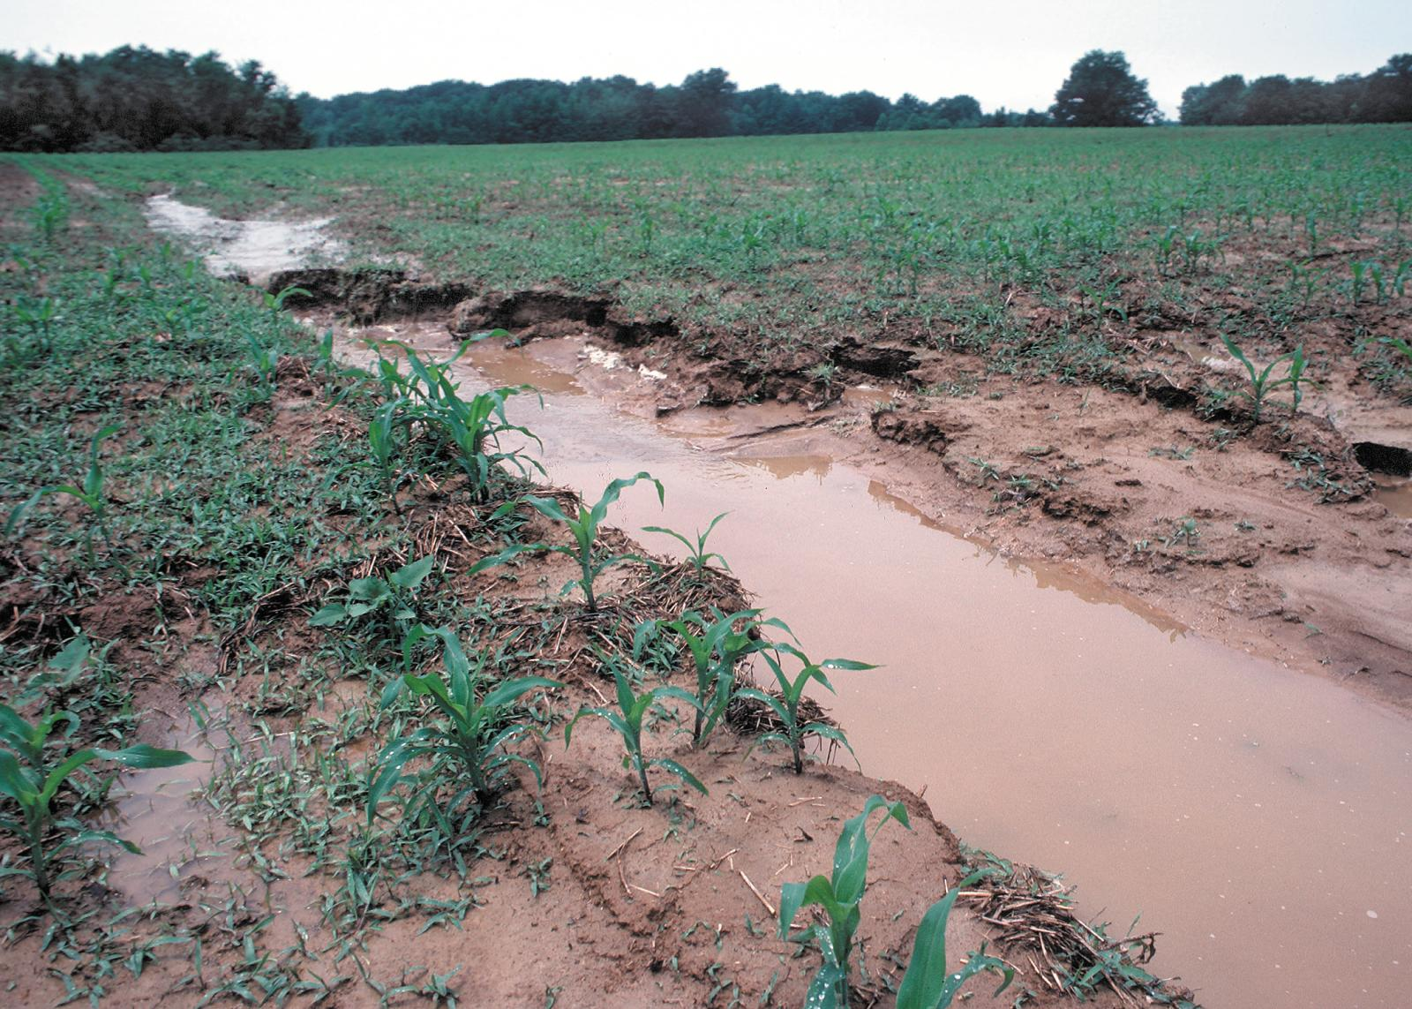
CREP CP26, Sediment Retention Control Structure
Why establish sediment retention control structure?
reduces agricultural runoff and sediment loading in nearby streams
prevents small areas of concentrated flow from becoming gullies
helps control erosion on aera of hilly land where slopes are not uniform enough for practices that flow the contour
improves the farmability of cropland with irregular topography

Slide 36
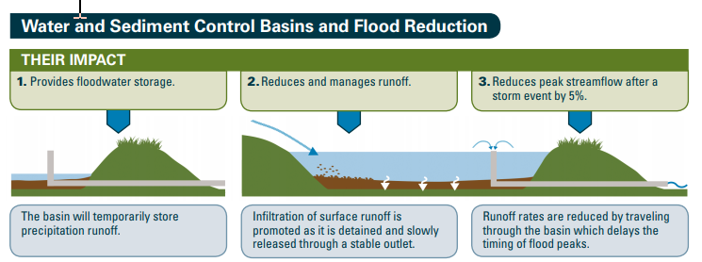
CREP CP26, Sediment Retention Control Structure
Why establish sediment retention control structure?

Slide 37
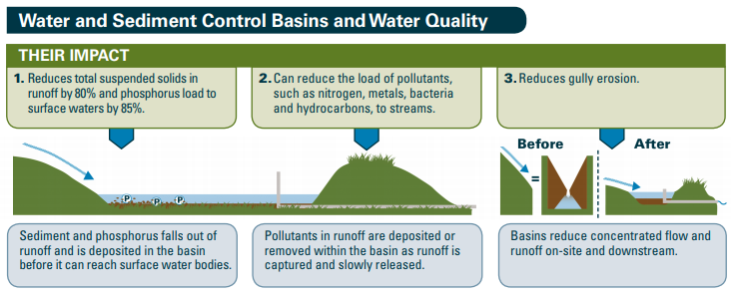
CREP CP26, Sediment Retention Control Structure
Why establish sediment retention control structure?

Slide 38
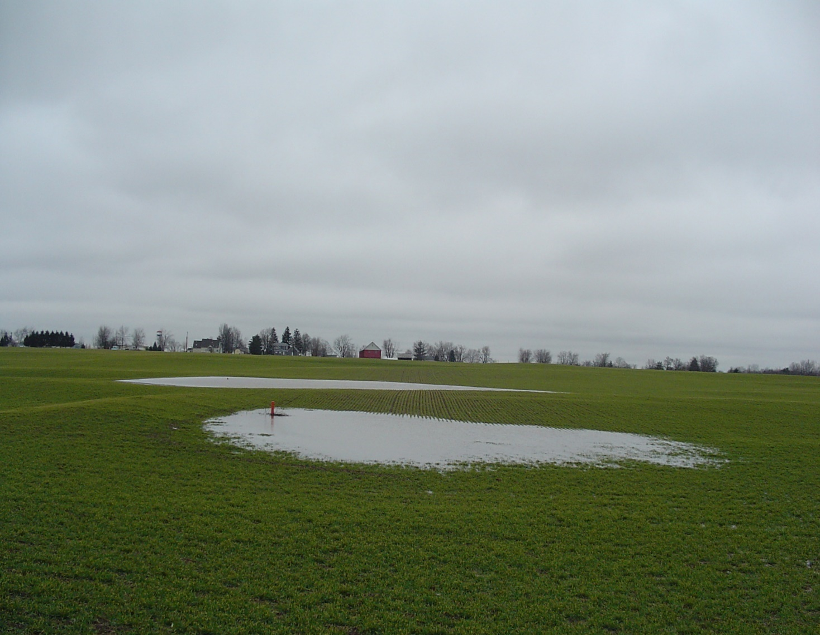
CREP CP26, Sediment Retention Control Structure
Why establish sediment retention control structure?
They detain precipitation runoff during storm events and slowly discharge this water through a stable outlet, which reduces streamflow by 5%. Sediment in the runoff is deposited in the basin, removing 80% of total suspended solids in runoff, reducing the phosphorus load by 85% and improving downstream water quality. These basins eliminate gully erosion and can also remove pollutants such as nitrogen, metals, bacteria and hydrocarbons. The dry basin between storm events maintains land function and farmability and vegetation along the basin edge provides wildlife habitat

Slide 39
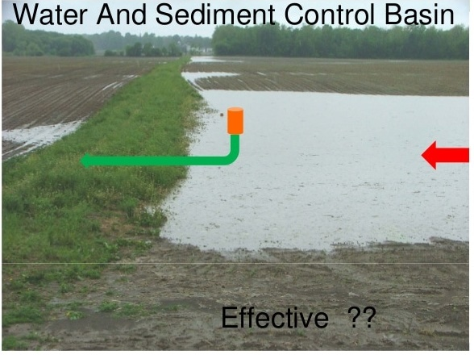
CREP CP26, Sediment Retention Control Structure
Practice Requirements
This practice must include an adequate buffer area of perennial vegetation to protect the water quality and provide wildlife habitat. The width of the buffer shall be determined by the soil types, slope, and conservation practices applied on the field.
the earth embankment and inundated area must be devoted to a cover comprised of a mixed stand of at least two forb or legume species best suited for site conditions in accordance with the NRCS FOTG.
the buffer area of perennial vegetation to protect the water quality will be designed as determined by NRCS.

Slide 40
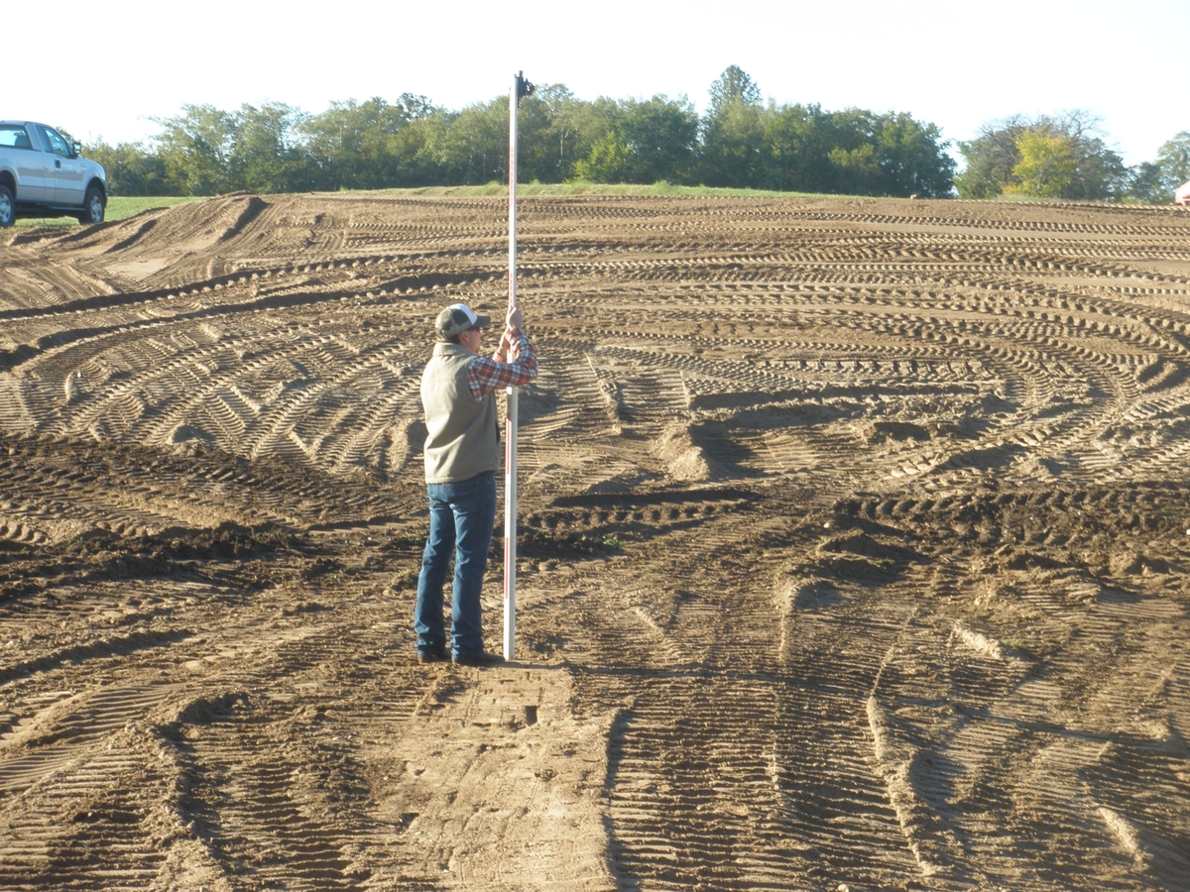
CREP CP26, Sediment Retention Control Structure
Practice Requirements
Sediment retention control structures shall be designed and installed to meet the minimum criteria to trap a significant portion of sediment and other pollutants from incoming runoff.
  the structure shall be designed to control runoff from a 10-year, 24-hour duration storm
  the basin shall have the capacity to store an anticipated 10-year sediment accumulation
  the basin shall have a maximum of 1 foot of freeboard to provide for an emergency spillway around one or both ends of the embankment
  the maximum settled height of the structure shall be 15 feet measured from the natural ground at the centerline of the embankment to the top of the fill material

Slide 41
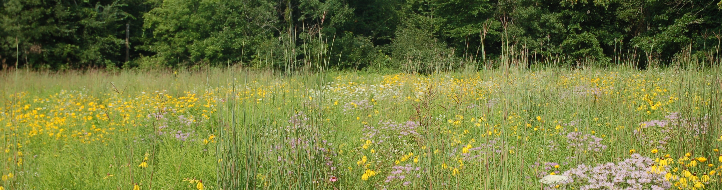
Maintenance Activities
Cover maintenance is the participant’s responsibility after NRCS completes a site visit to determine that the approved permanent cover is fully established. Participants must maintain practices, according to the conservation plan, without additional C/S assistance.
Maintenance activities are conducted for weed and/or insect control, to prevent undesirable species from adversely impacting the approved established cover. Activities include mowing, spraying, or prescribed burning in a logical and practical manner. Mowing for cosmetic purposes or generic weed control is prohibited and will result in financial penalties. Maintenance activities shall be conducted outside the primary nesting season, unless a written request has been submitted to the COC and approval for such activities has been provided (COC’s shall consult NRCS or TSP).
Cover | Recommended Maintenance Activities
Grass Plantings | Mowing , herbicide, prescribed burning
Tree Plantings | Herbicides or mechanical methods for weed control immediately around each tree. Mowing is typically ineffective and not allowed for weed control with tree plantings.

Slide 42
Management Activities
All CRP participants with CRP-1’s effective beginning June 3, 2019, are required to perform at least 1 required management activity. DAFP approved Michigan practice specific management activities are listed in MI Exhibit 5 to 2-CRP (Rev.6).
Management activities are designed to ensure plant diversity and wildlife benefits while ensuring protection of the soil and water resources. Management activities are site specific and are used to enhance the wildlife benefits for the site. Management activities must be completed before the end of year 6 for CRP-1’s with a 10-year CRP-1 period, or before the end of year 9 for CRP-1’s with a 15-year CRP-1 period.
In no case should the 1 required management activity occur during the last 3 years of the CRP-1 period. However, additional management activities may occur up to year:
8 for 10-year CRP-1’s
13 for 15-year CRP-1’s
Cover | Recommended Maintenance Activities
Grass Plantings | Grass specific herbicide, prescribed burning, light disking, and interseeding
Tree Plantings | Tree thinning and/or pruning

Slide 43




Questions?
Thank you for attending
Contact:
[add contact info here]

